Slide 1

Mobile App Behaviour Analysis
Group 7 Section 003
Aashutosh Sehgal – 0780170
Dattu Reddy Pedholla – 0782042
Devashish Patel – 0781214
Rachna Rachna – 0782821
Rohit Rohit - 0773987

Slide 2
Overview of Problem
The objective of this project is to predict which customers are not converting to the paid subscription category in order to refocus and redouble marketing efforts to increase revenue and sales.
We will also determine which screens are visited the most by the users.

Slide 3
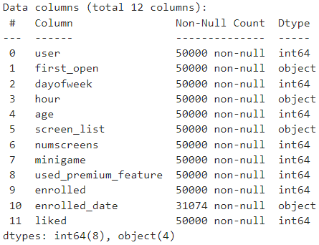
Review of Data Source
The dataset named appdata contains of 50000 rows and 12 columns. Each row represents a user(customer) while the 12 columns represent the app usage statistics like first time the app was opened, the hour at which it was used etc.
The columns are defined as follows:
user - shows the user number or user ID.
first_open – shows the time and date the app was opened for the first time.
dayofweek – shows the day of the week the app was opened.
hour – shows the hour at which the app was opened.
age – shows the age of the user.
screen_list – shows the names of the screens the user visited.
numscreens – shows the number of screens visited by the user.
minigame – shows whether the user played the minigame (0 - No or 1 - Yes).
used_premium_feature – shows whether the user subscribed for the premium feature(0 - No or 1 - Yes).
enrolled – shows whether the user is enrolled (0 - No or 1 - Yes).

Slide 4
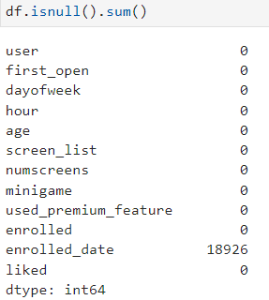
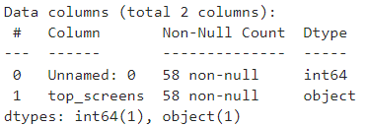
enrolled_date – shows the time and date of enrolment of the user.
liked - shows whether the user liked the app (0 - No or 1 - Yes).
After a preliminary look at the data, we notice that there are a lot of null values in the enrolled_date column. All other columns do not have any null values.
We can also see that the hour column is not in integer format. For further analysis, it is important to convert this in integer format to work on this column and visualize other columns with this data.
The second dataset named popular_screens shows the screens visited the most by the users. There are a total of 57 rows(screens) in this dataset. There is only 1 column in this dataset. The other column is just the serial number column, so it adds no specific value to the data.

Slide 5
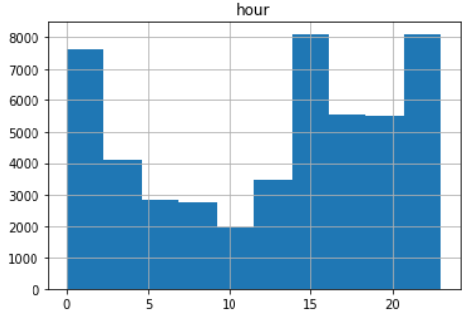
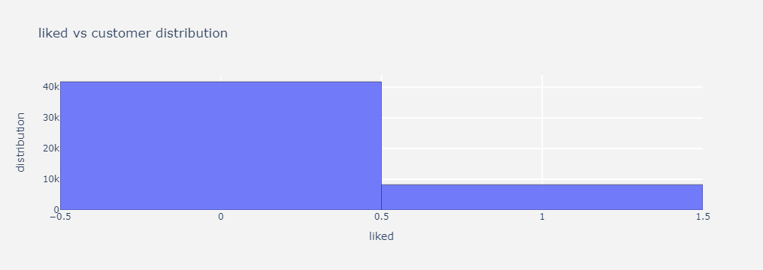
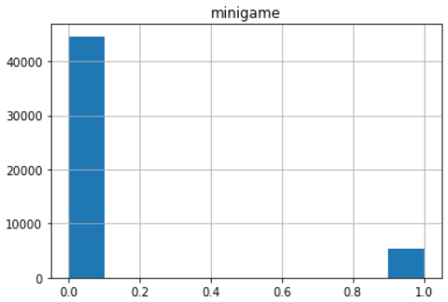
Descriptive Insights
As you can see in the charts shown, we created similar charts for each of the 12 variables and determined the following:
Most of the users opened their accounts on 'Sunday' and 'Thursday' while the lowest number of accounts opened was on 'Tuesday'.
Most accounts were opened around 1:00, 15:00 and (21:00 - 23:00), while it was comparatively lower in the morning from (5:00 - 13:00).
The ratio of number of users who did play games as compared to the ones that did not is very small.
Nearly 85% of the users did not click the like button even once.
We performed data cleaning and used the new dataset for analysis which was free of duplicates/null values and converted hour column into integer format.

Slide 6
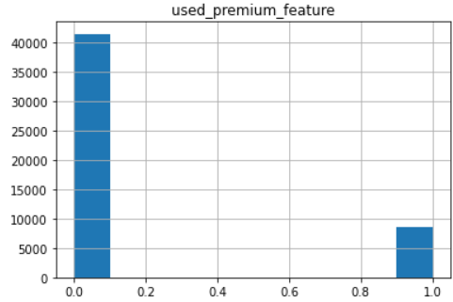
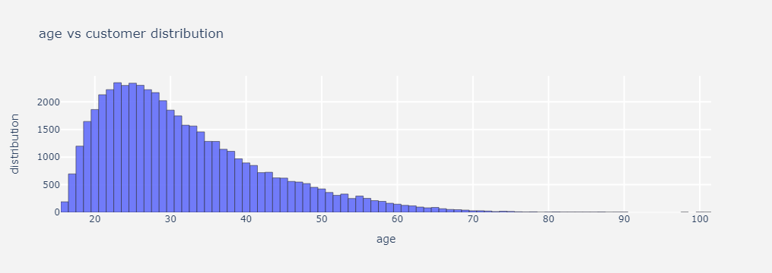
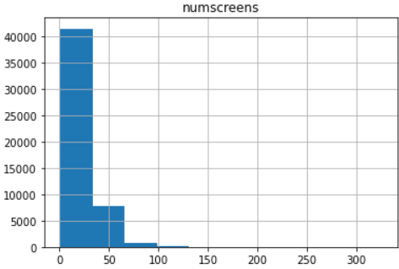
RESULTS
There were around 42000 users who have not used any premium feature in their free trial period. However, around 8000 users used premium features at that time.
A large proportion of users visited approximately 40 screens in their first 24 hours.
Majority of the users are aged between 15-40 years.

Slide 7
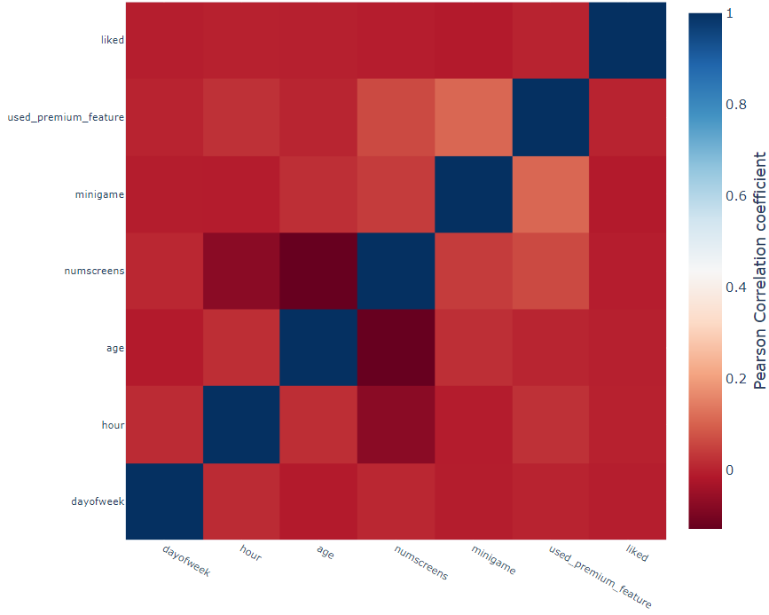
Interpretation
From the heat map we can see that there is almost no correlation between the fields.
This matrix shows us that there is almost no dependability between most of the variables. Some variables that do not follow this phenomenon are used_premium_feature vs minigame and age vs numscreens.
Correlation Matrix for Variables

Slide 8
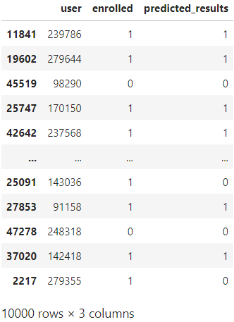
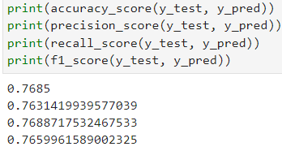
Model Interpretation
We created a machine learning model based on logistic regression. This model used feature scaling with the enrolled column being its predictor variable.
Based on the confusion matrix as well as cross-validation score, our model is working correctly with 76% accuracy.
For this model, we created a new column called predicted_results which will predict whether a customer will keep subscribing for the paid version of the application.

Slide 9
Future recommendations/PROPOSAL
We observed that the ratio of users that are using the paid version vs the ratio of users that are using the free version is very low. This ratio needs to improve for the company to grow which can be done with new promotion strategies.
We also noticed that the customer base has a high age range. This is a potential goldmine and performing segmentation can help to promote and target the customers in more efficiently.
For the same reasons, a second study/project will be crucial to:
Improve the model accuracy to such an extent that the predicted_results column is highly accurate, and this will help the marketing team understand what a customer is going to do in terms of staying a paid customer.
Understand the KPI’s in terms of the individual features and how the correlation of these variables will affect marketing strategies further.

Slide 10
THANK YOU

